Slide 1


My Movies

Slide 2







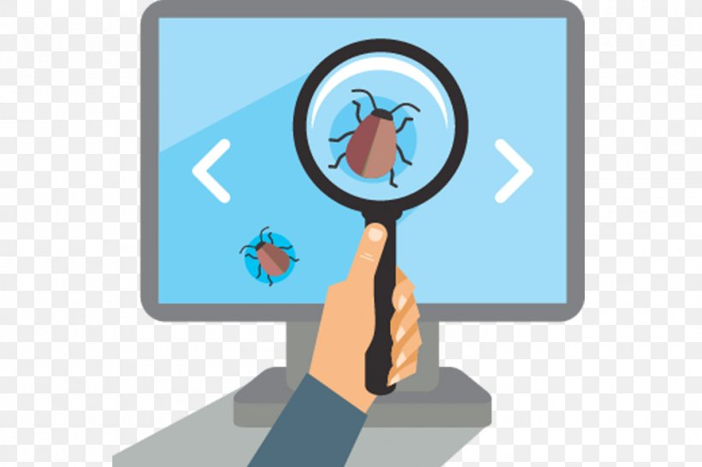
Team members
Moshe Yakov
Team Leader
Dev Ops
Scrum Master
Team
Orli Guy
UI/UX Engineer
Team
Amit Goldshtein
Technical Writer
Product owner
Team
Nadav Kaldes
QA Engineer
Team
Hanan Ben Shabat
Database administrator
Team
Notes:
כל אחד רצה להתנסות בתחומים חדשים ולהוסיף את חוסר אנשי הצוות כך שהיינו צריכים להעמיס תפקידים נוספים לחברי צוות

Slide 3
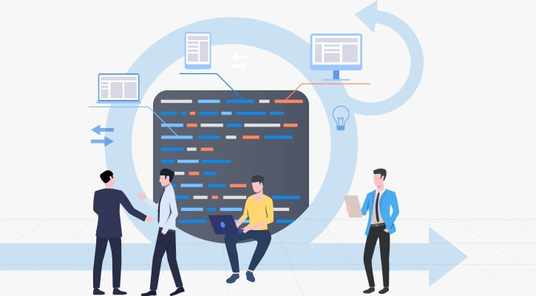
Description & Purpose
"My Movies" is a web app that helps the user create a watch list of movies/tv series they intend to watch, rate and view ratings of movies/tv series from other users.
Notes:
ההשראה נלקחה מאתרים של שרותי סטרימינג ואתרי ביקורות

Slide 4

















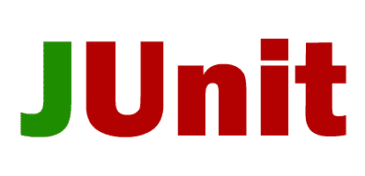
Technologies

Slide 5
Architecture
Client
Server
Database

Slide 6
Class Diagram
Season
Id
season number
numberOfEpisodes
usersWatched
Series
Movie
1..*
Id
Name
director
main cast
genres
description
rating
ratingAmount
ratingSum
year
language
origin
usersWatched
Id
name
director
mainCast
genre
description
rating
ratingAmount
ratingSum
year
language
origin
numberOfSeasons
numberOfEpisodes
usersWatched
markIfWatched()
1
1
WatchList
1..*
0..*
1
Id
active
userId
1
0..*
Episode
Id
episodeNumber
name
description
usersWatched
rate() between 0-10
addToWatchList()
removeFromWatchList()
markIfWatched()
addMovie()
removeMovie()
rate() between 0-10
addToWatchList()
removeFromWatchList()
markIfWatched()
markIfWatched()
Notes:
1. הדיאגרמה הינה עבור משתמש אחד
2. להציג ולהסביר על השדות בקצרה
3. להסביר על הקשרים בין המחלקות

Slide 7
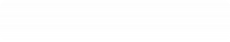

Requirements
Non Functional Requirements
Watch details of movies/series
Supportability - logging
search movie/series
add movie/series to watch list
remove movie/series from watch list
user
rate movie/series
mark movie/series/season/episode he watched

Slide 8


Digital dust
Media preferences of users
Media that the users are going to watch soon
Media that users didn’t watch yet
What media is popular
Genre preferences of users

Slide 9
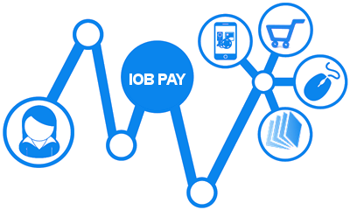



Roadmap for the future
UI/UX
IOB
Streaming
Create Recommendation algorithm
Complete working on the client
Create an option of watching movies/series




Security
Harden cyber security

Slide 10
THANK YOU !

